Slide 1
Amsterdam Birsdscan MR1 at ARTIS Overview of data from 11/03/2021 to 31/08/2021
The following data is extracted from the PostgreSQL cloud database and processed using the MR1 Analysis Tool developed by SBRS
Further analysis is performed in Python
The mean MTR per day/night is calculated in a single altitude bin between 25m and 1025m for the creation of MTR time series
Only short pulse data is used
The probability of classification cutoff is set to 0.3. Echoes with a lower probability of classification are excluded
Echoes for which “observation time”/”time duration bin” < 0.2 are also excluded
Birds and insects are identified. Birds are classified into: passerine, wader, swift, large bird, unidentified bird, and flock

Slide 2
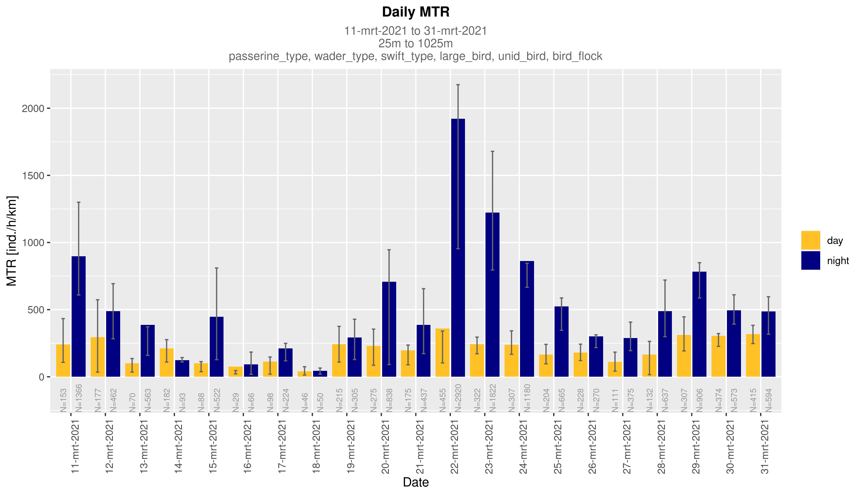
- Bar height: mean MTR of each day/night
- Spread: first and third Quartiles

Slide 3
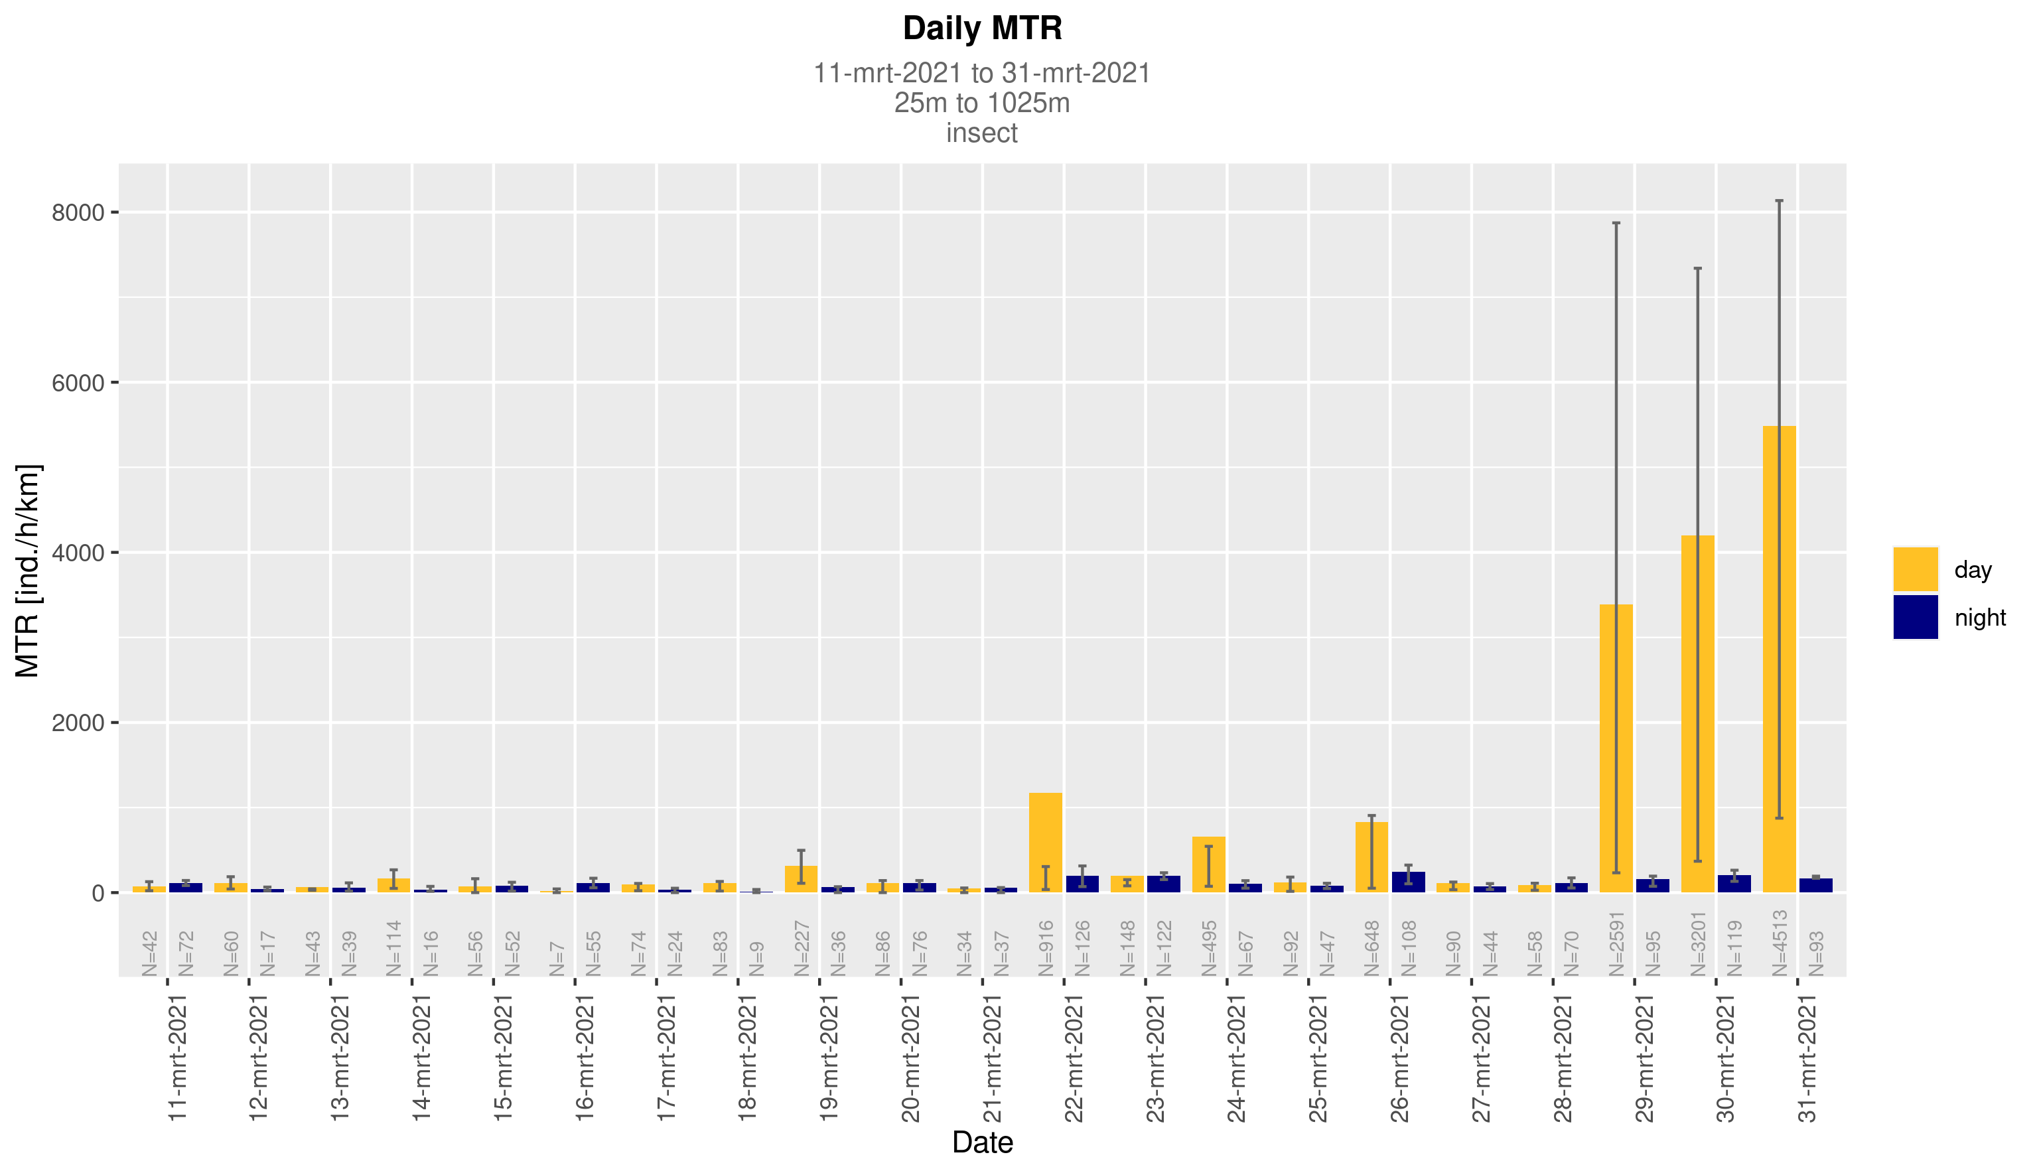
- Bar height: mean MTR of each day/night
- Spread: first and third Quartiles

Slide 4
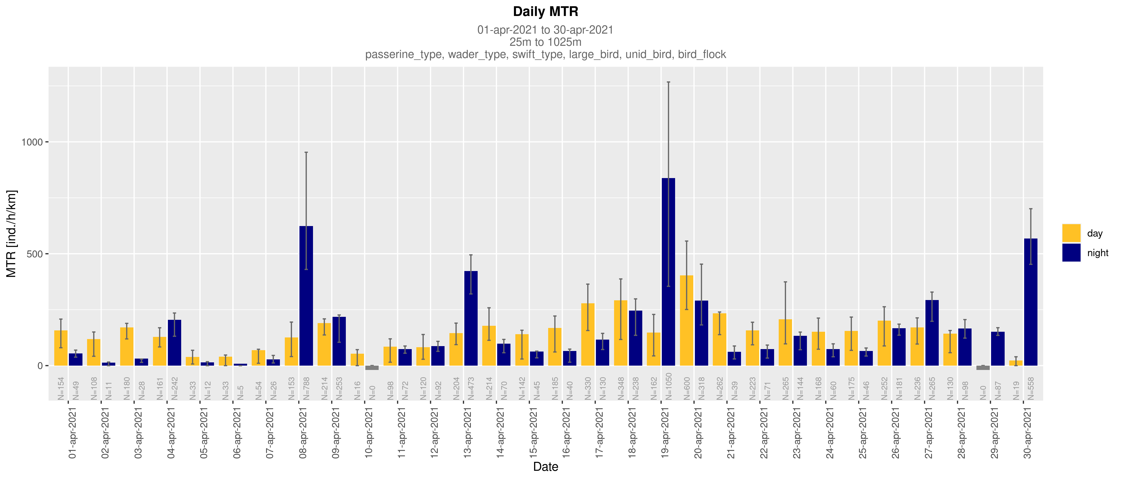
- Bar height: mean MTR of each day/night
- Spread: first and third Quartiles

Slide 5
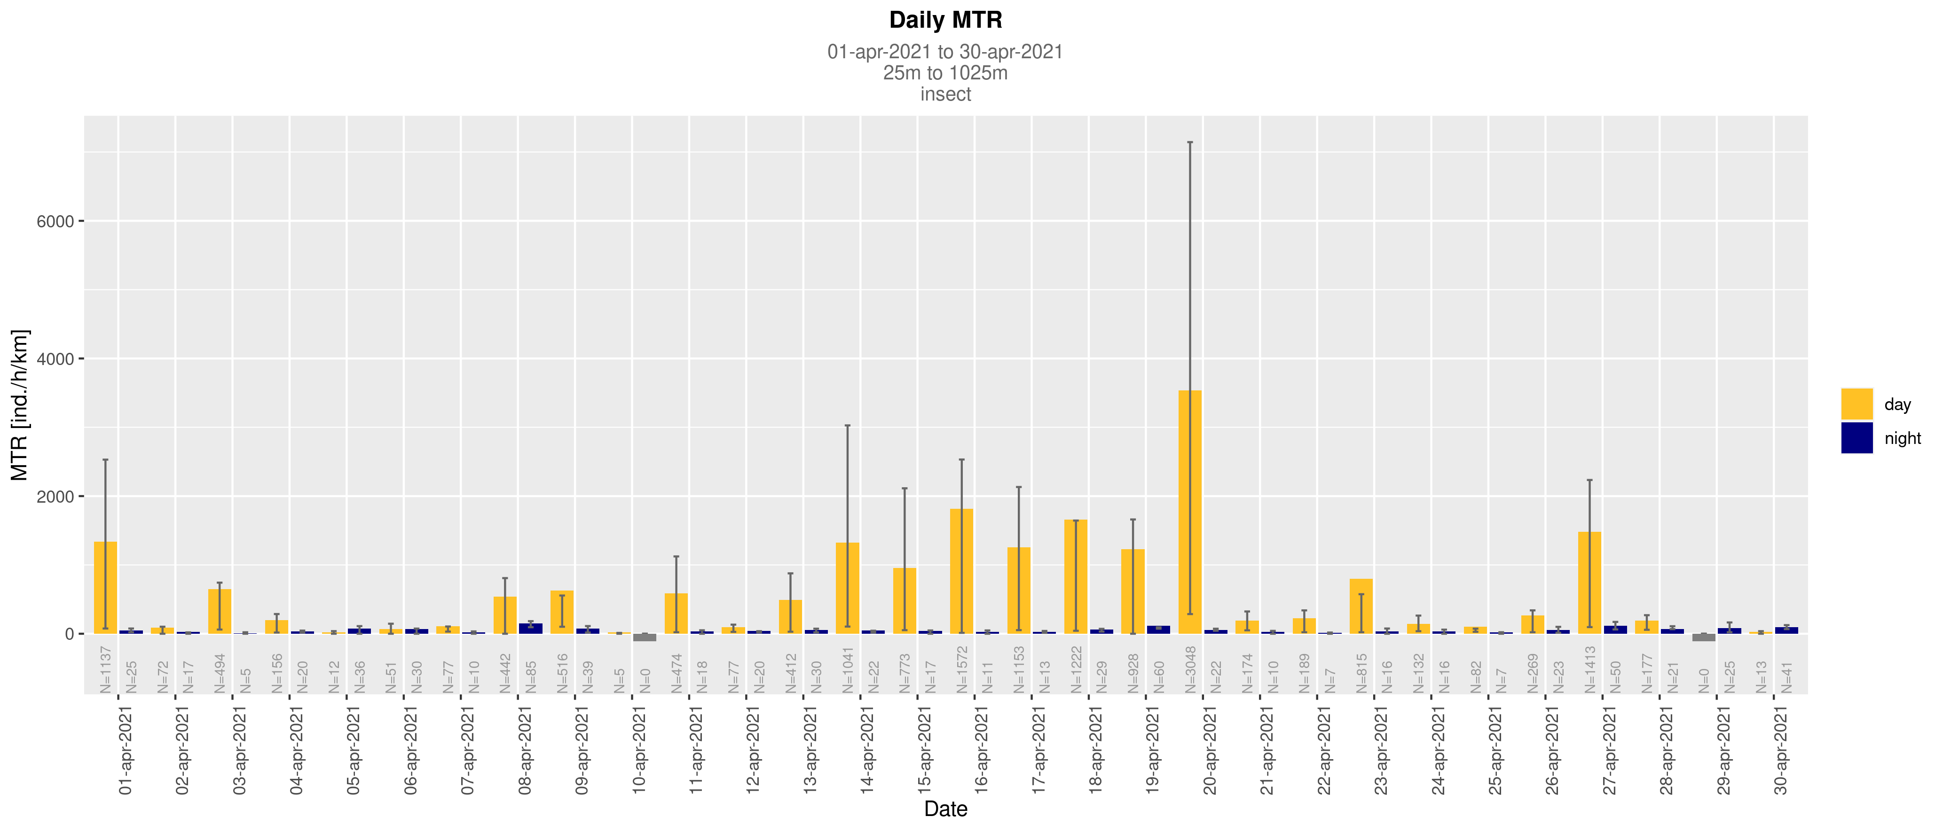
- Bar height: mean MTR of each day/night
- Spread: first and third Quartiles

Slide 6
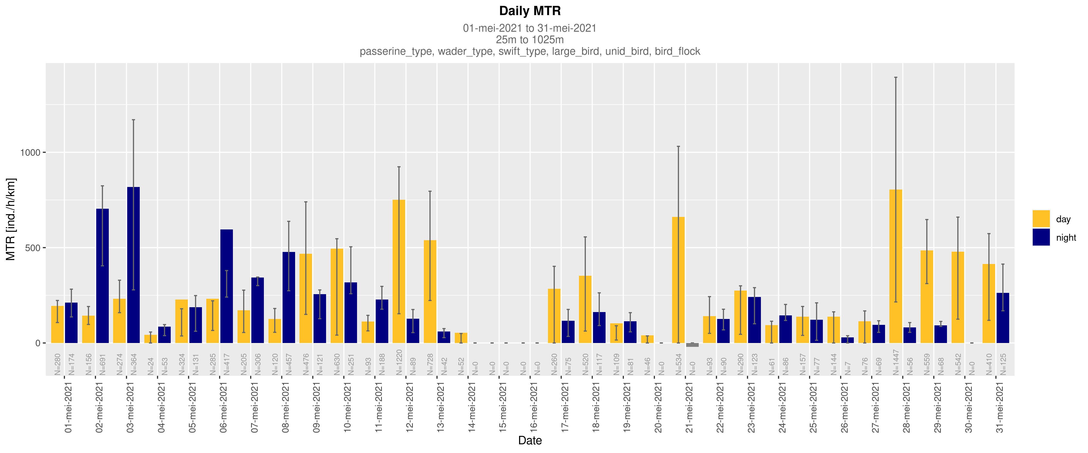
- Bar height: mean MTR of each day/night
- Spread: first and third Quartiles

Slide 7
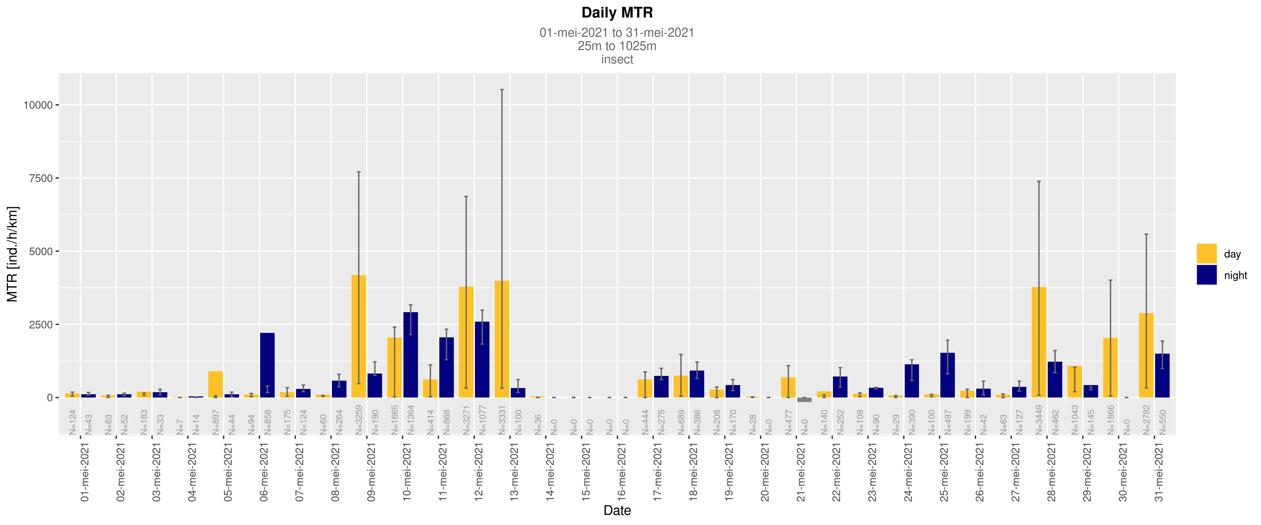
- Bar height: mean MTR of each day/night
- Spread: first and third Quartiles

Slide 8
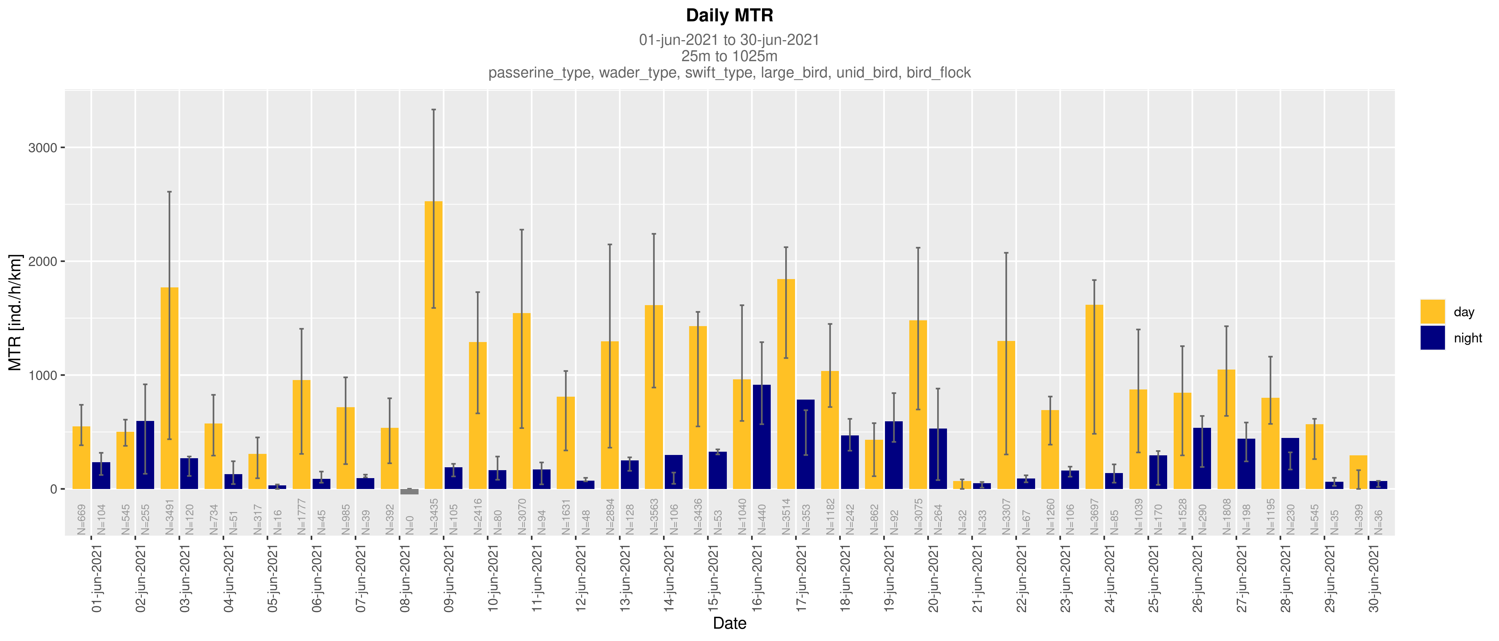
- Bar height: mean MTR of each day/night
- Spread: first and third Quartiles

Slide 9
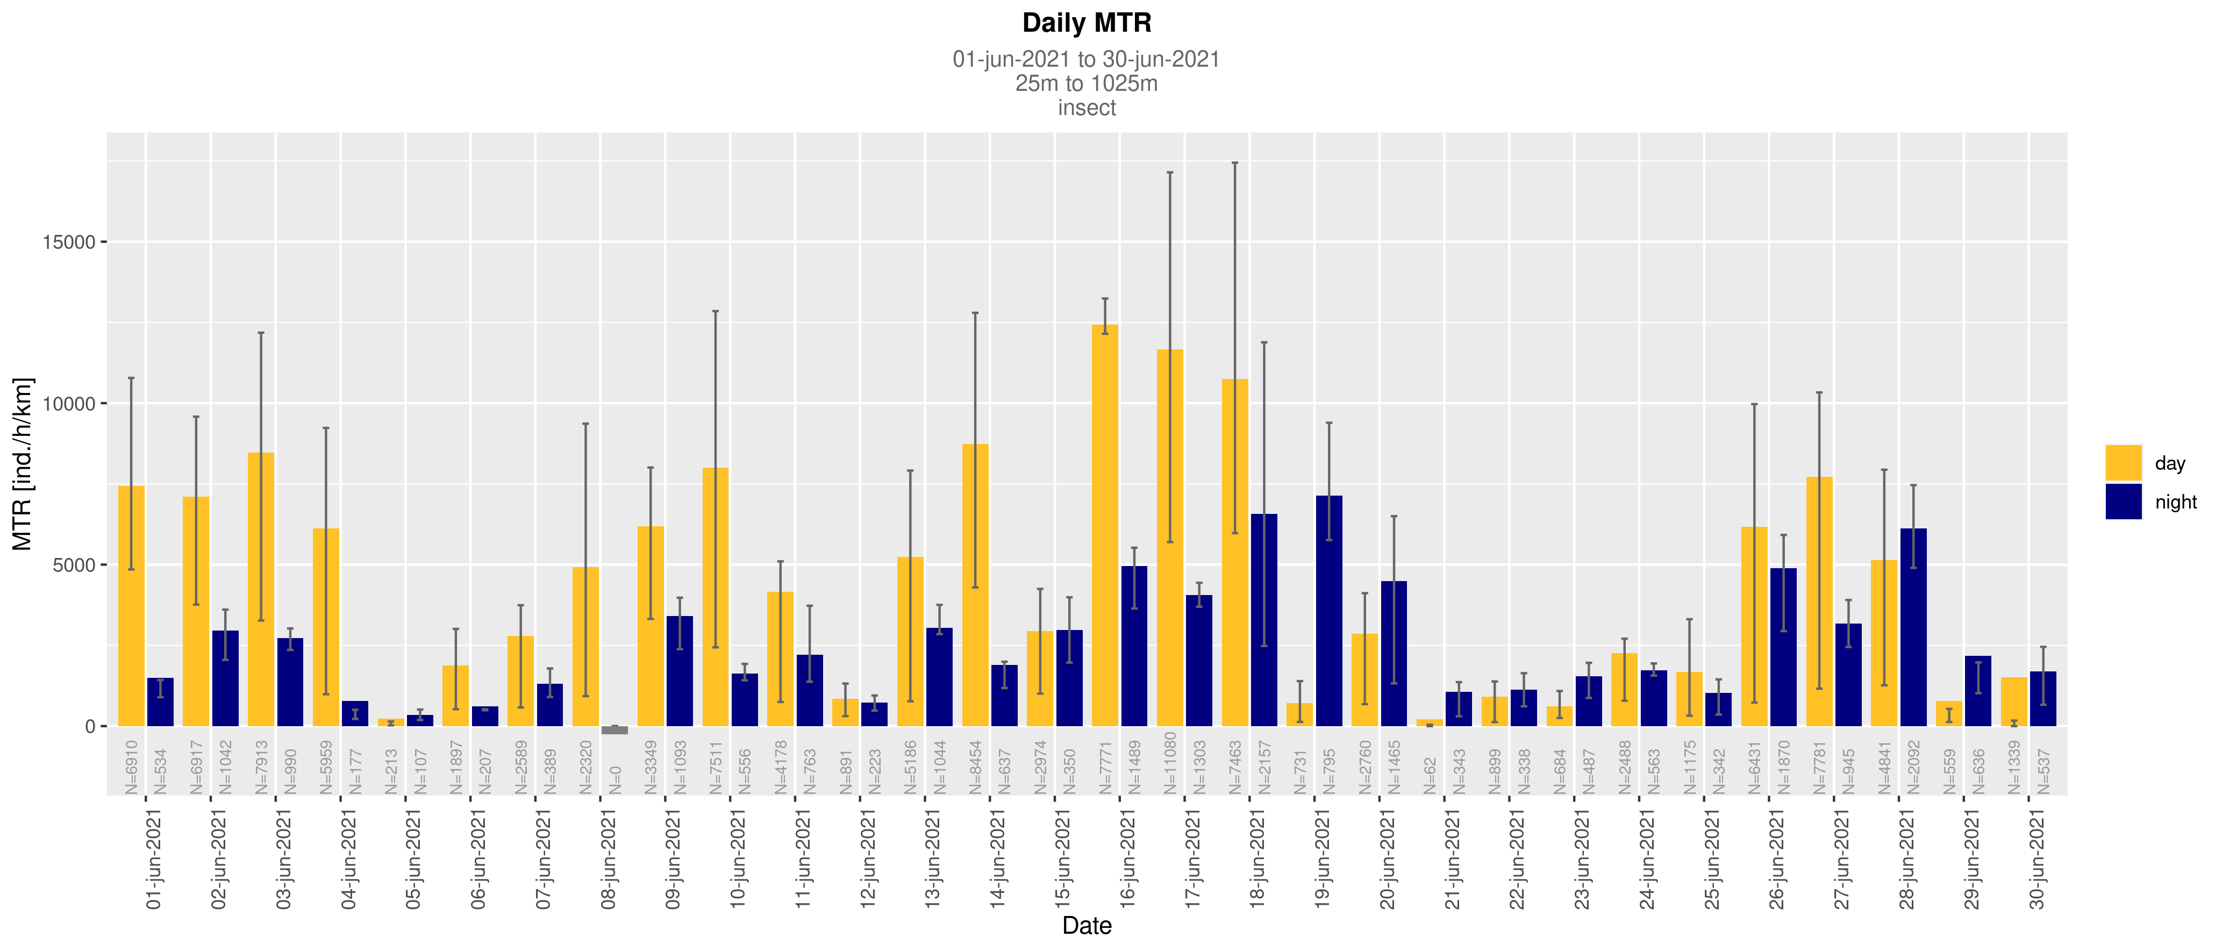
- Bar height: mean MTR of each day/night
- Spread: first and third Quartiles

Slide 10
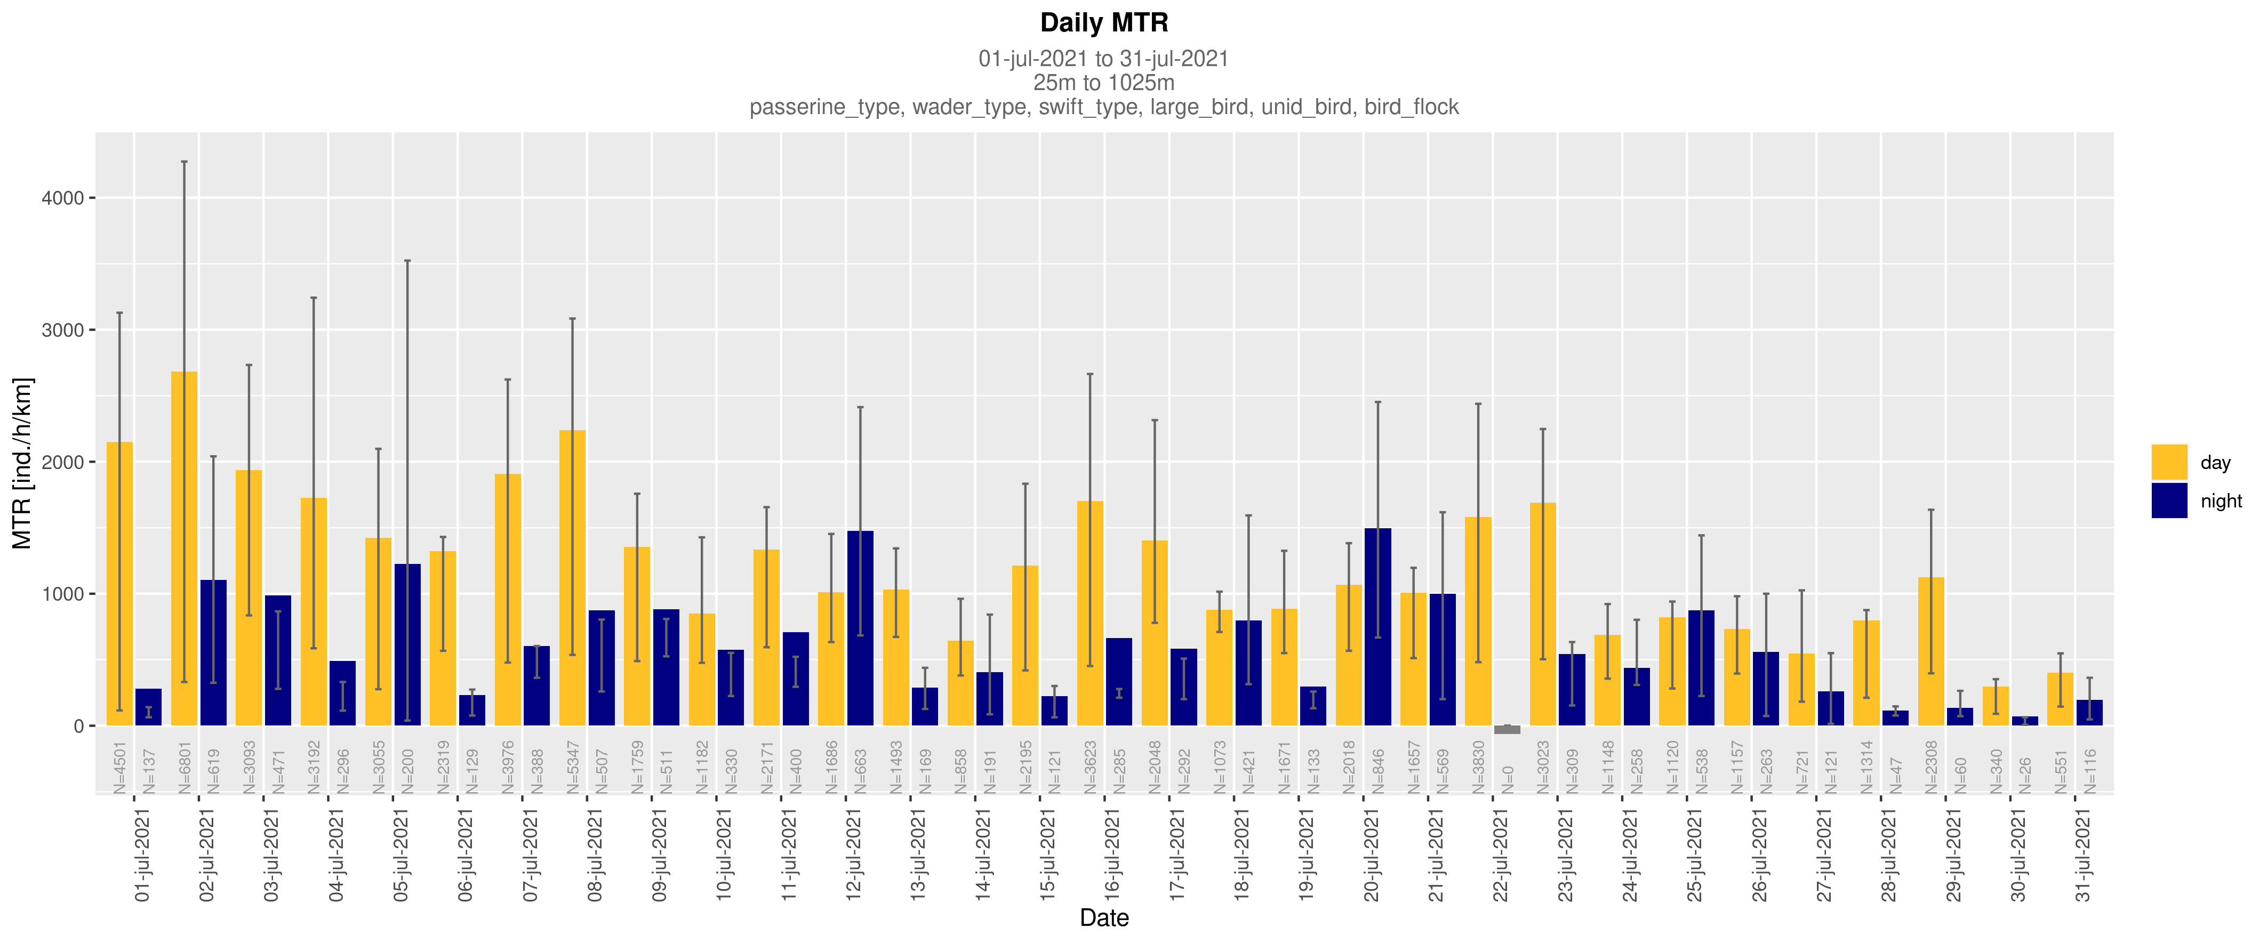
- Bar height: mean MTR of each day/night
- Spread: first and third Quartiles

Slide 11
- Bar height: mean MTR of each day/night
- Spread: first and third Quartiles

Slide 12
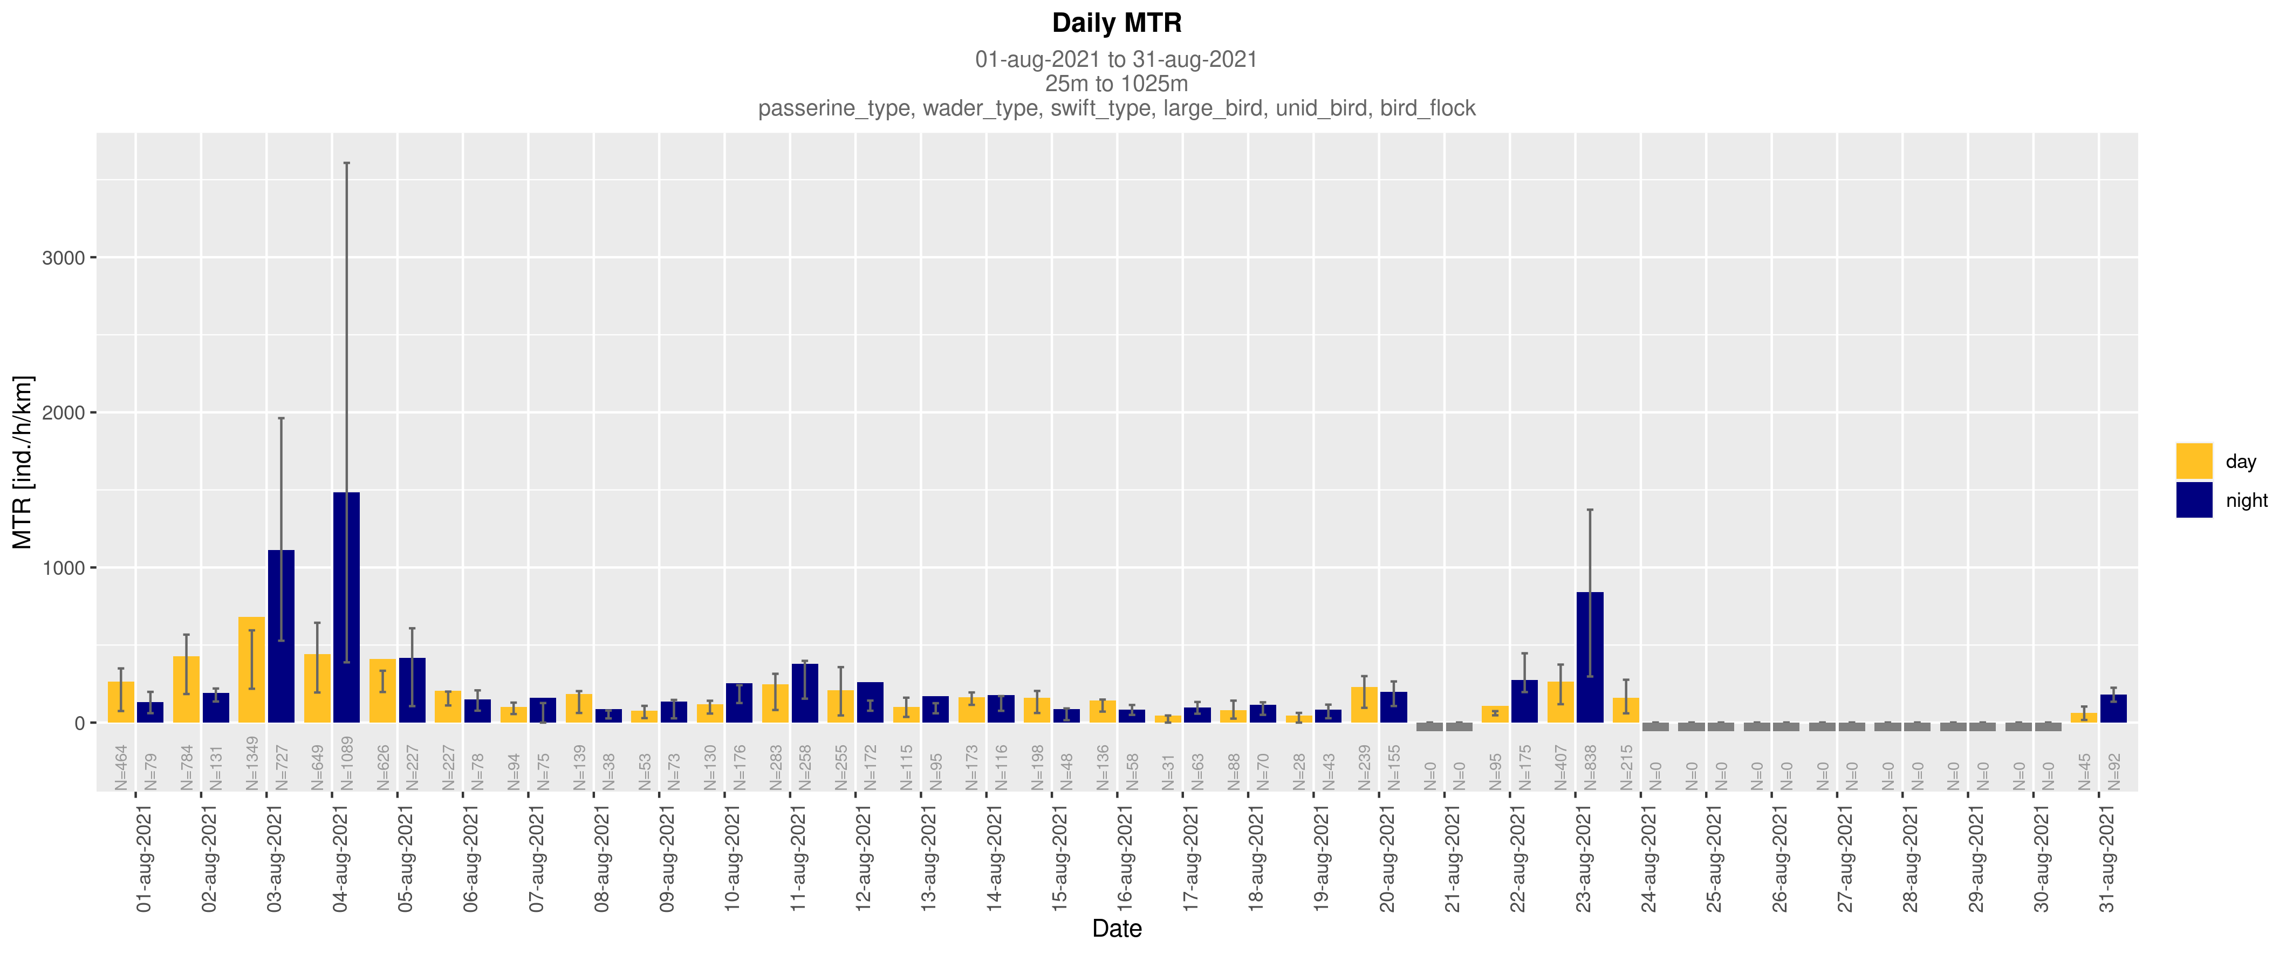
- Bar height: mean MTR of each day/night
- Spread: first and third Quartiles

Slide 13
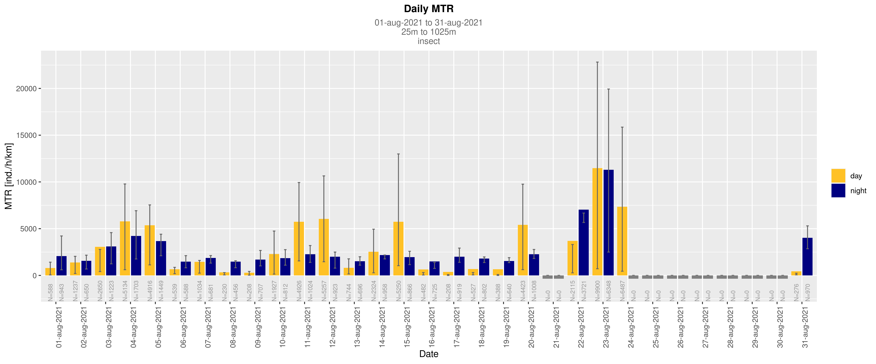
- Bar height: mean MTR of each day/night
- Spread: first and third Quartiles

Slide 14
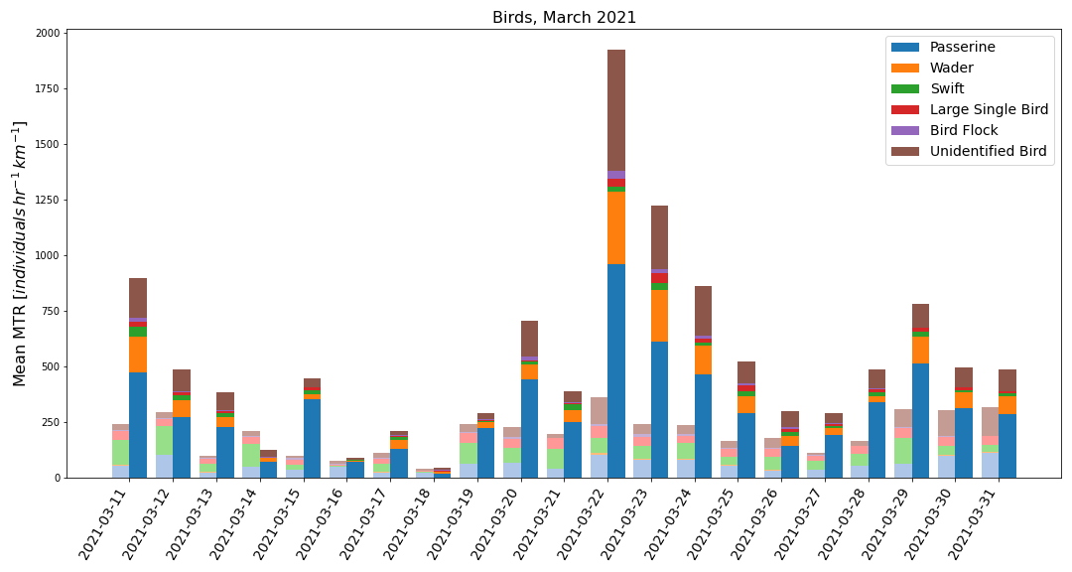
Light colors: day
Bright colors: night

Slide 15
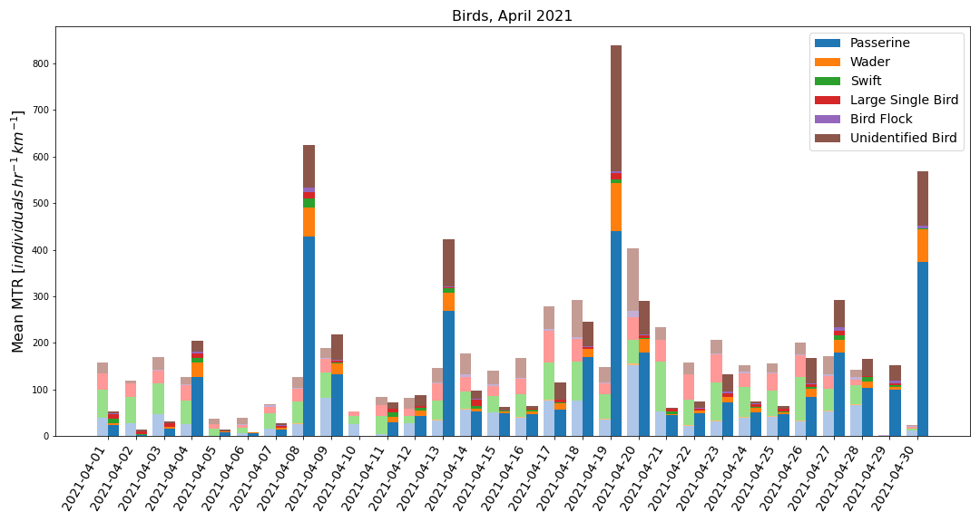
Light colors: day
Bright colors: night

Slide 16
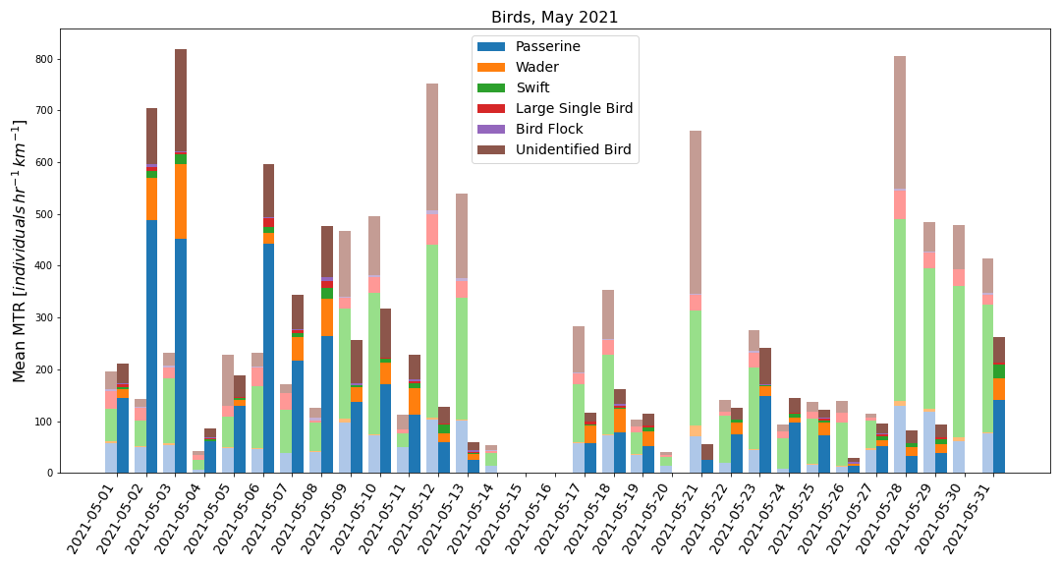
Light colors: day
Bright colors: night

Slide 17
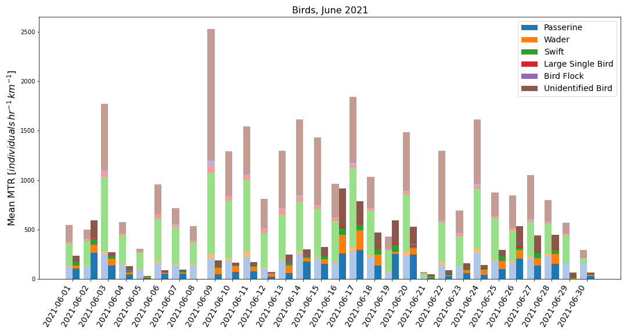
Light colors: day
Bright colors: night

Slide 18
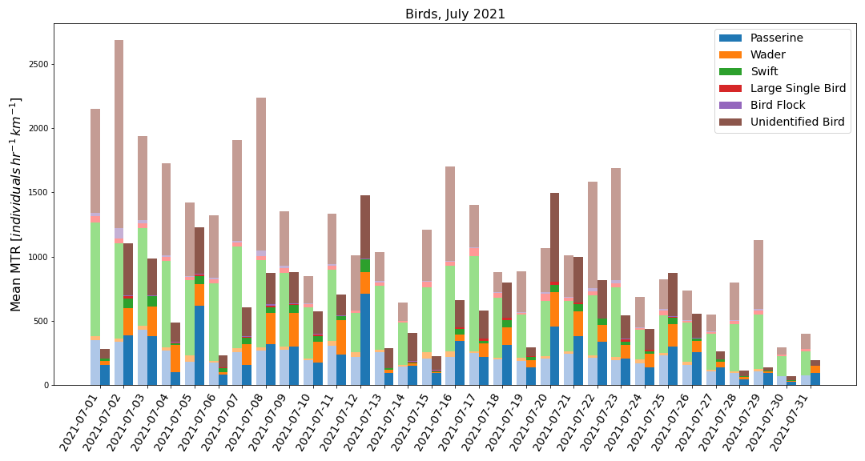
Light colors: day
Bright colors: night

Slide 19
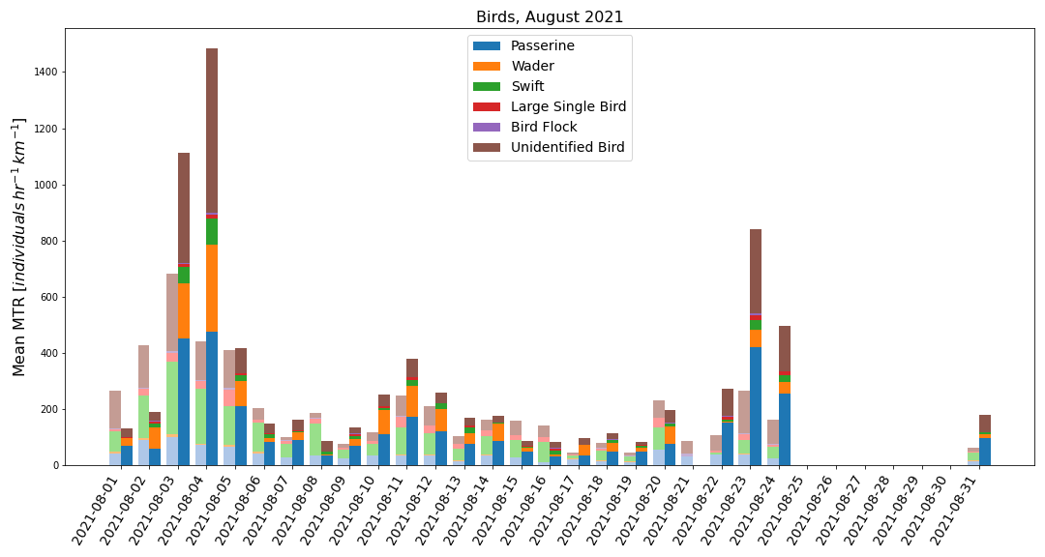
Light colors: day
Bright colors: night

Slide 20
The average MTR for each month, and the cumulative MTR throughout the entire month, versus (local) hour is calculated for birds and insects
Plots are created of MTR versus (local) hour for birds and insects together, and for different types of birds

Slide 21
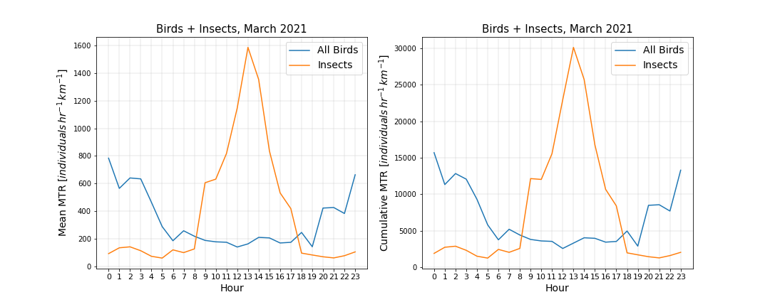
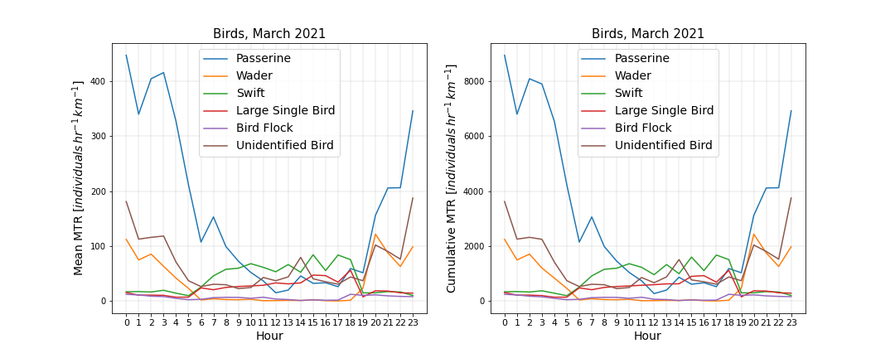

Slide 22
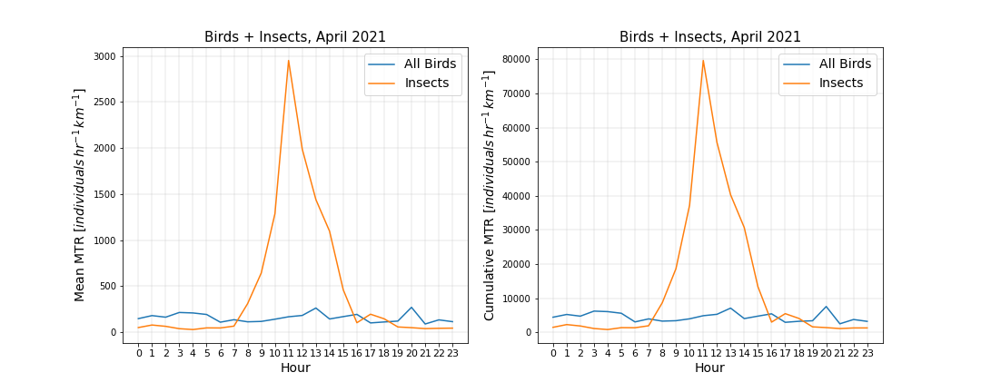

Slide 23
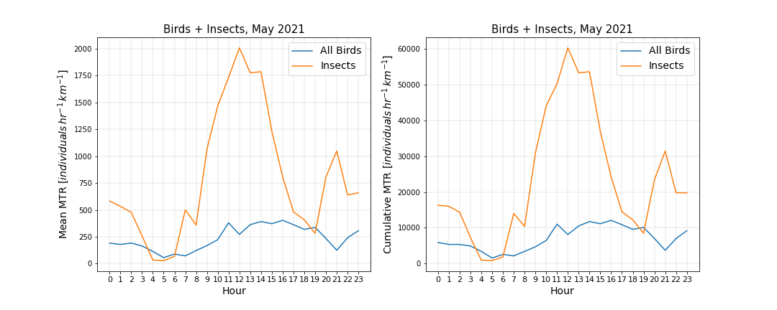
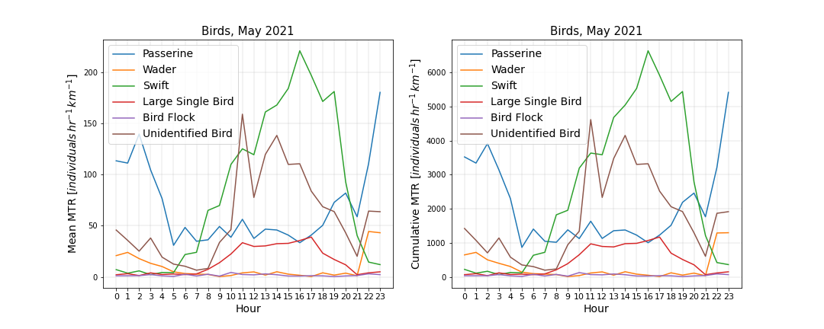

Slide 24
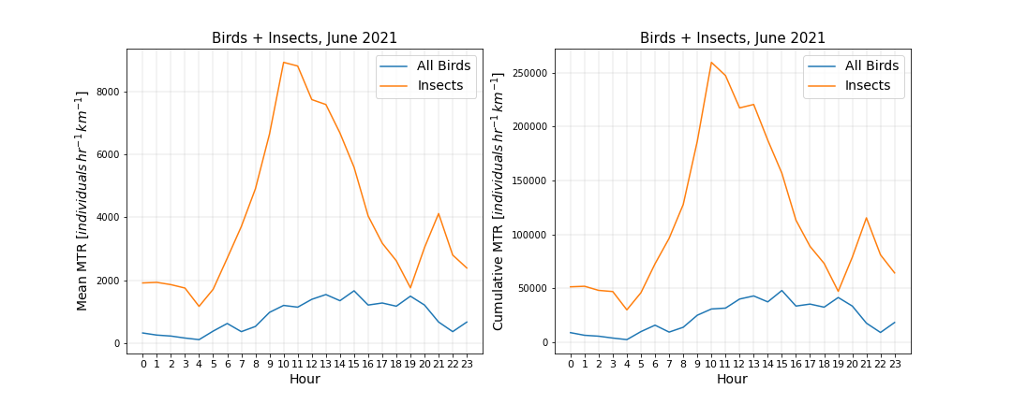
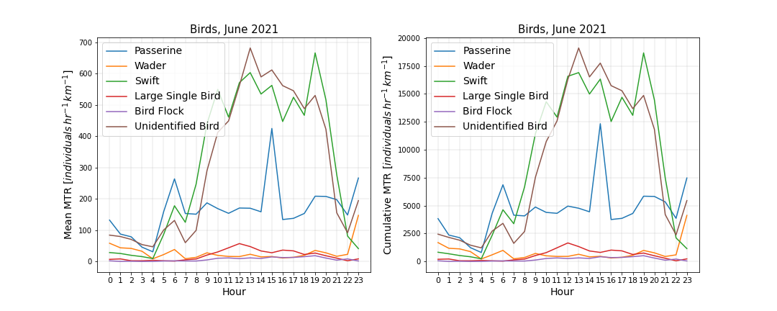

Slide 25
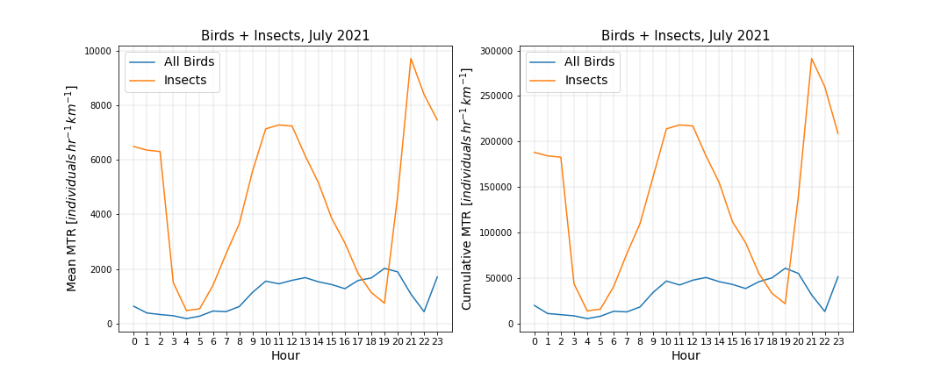
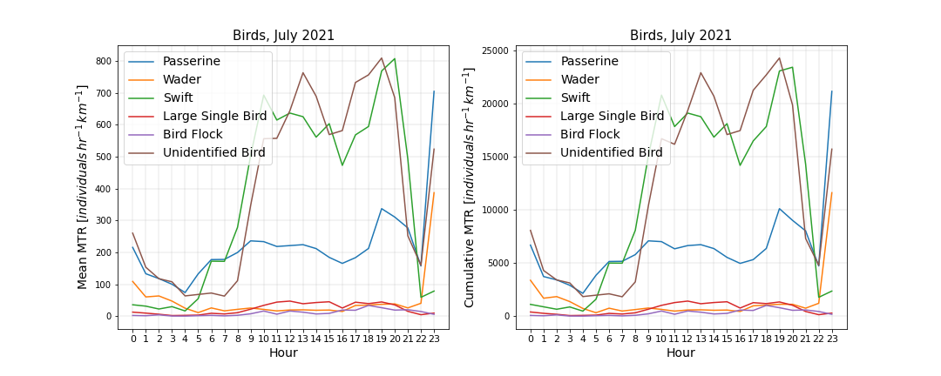

Slide 26
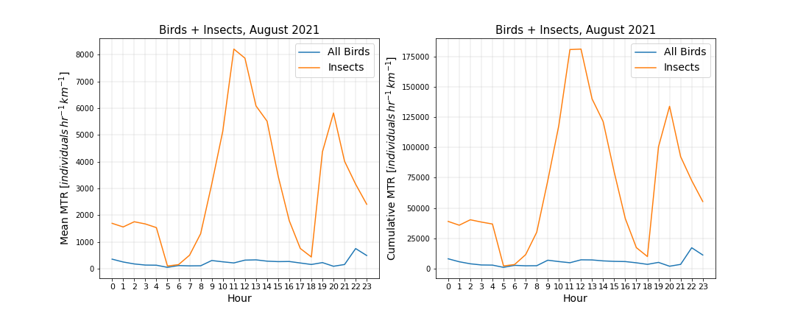
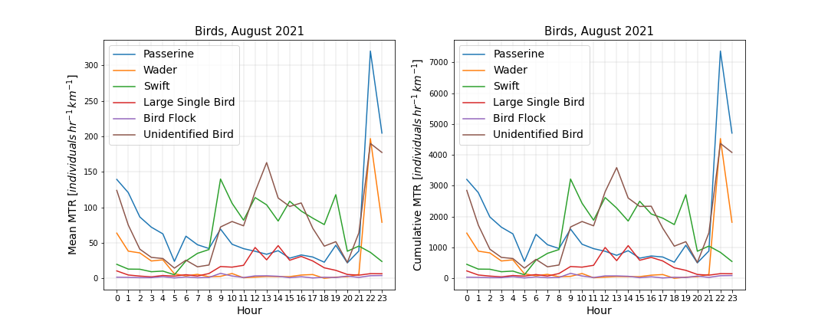

Slide 27
For the following analysis, data is extracted from pgAdmin using and the query “query_pgAdmin_20210907.sql”
Further analysis is performed in Python
The distributions of altitude, speed, and direction, for each month, and for birds and insects separately, are calculated given the following conditions:
“blind time”/”time duration bin” < 0.80
Probability of detection >= 0.3
Short pulse only
0m/s <Speed < 50m/s

Slide 28
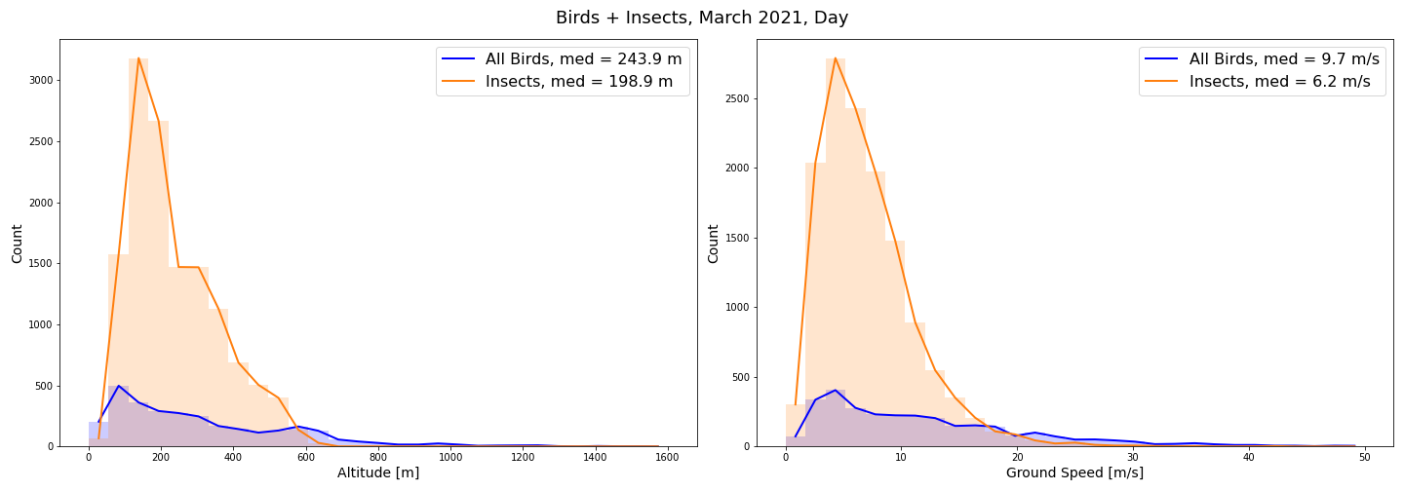
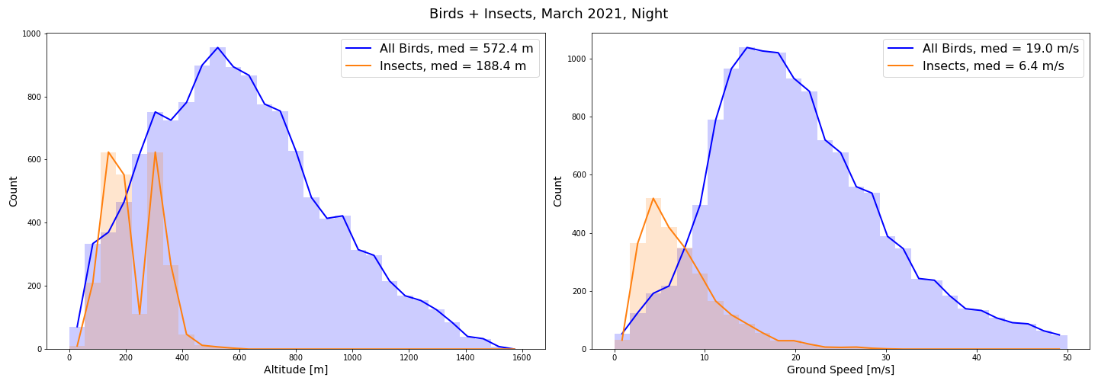

Slide 29
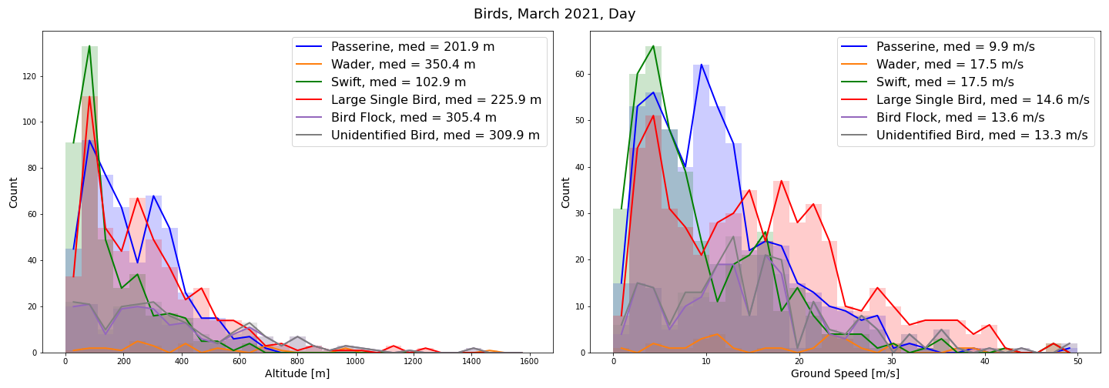
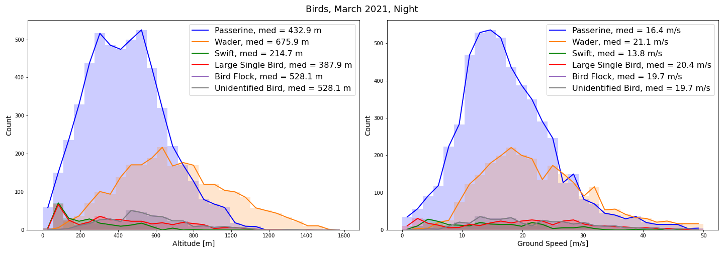

Slide 30
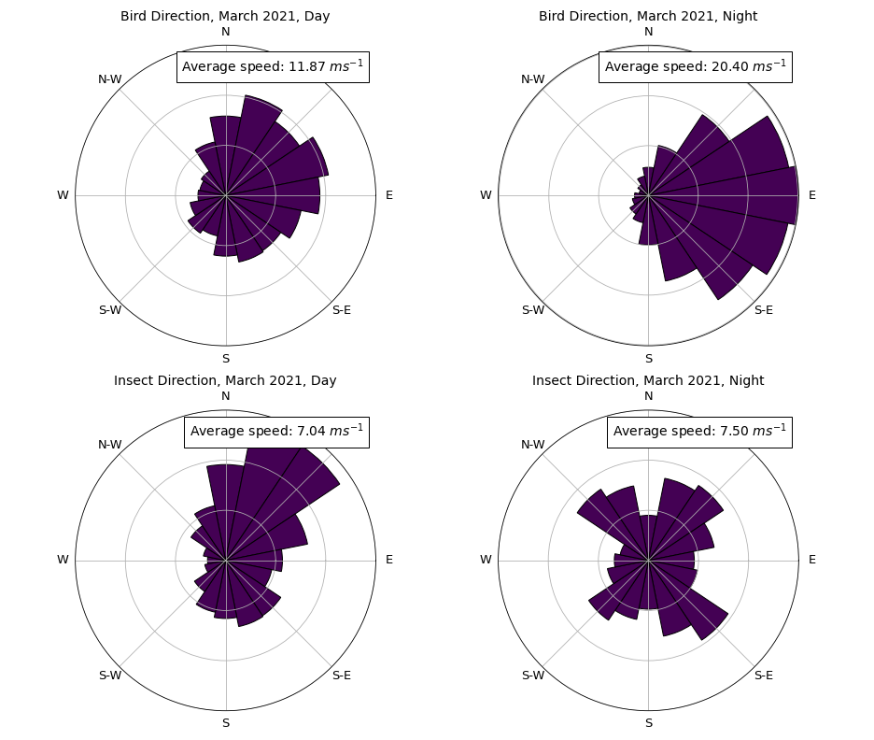

Slide 31
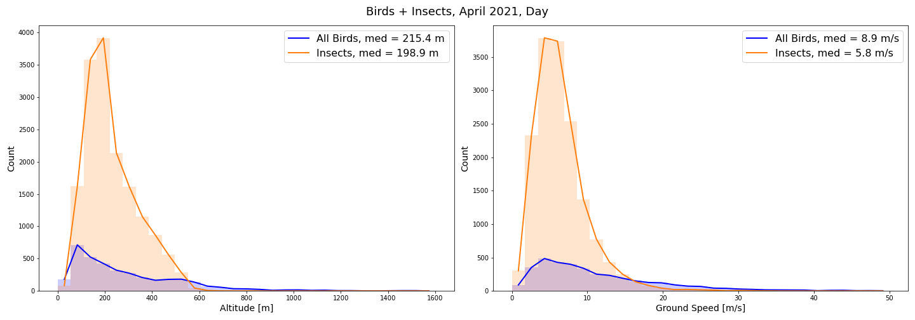
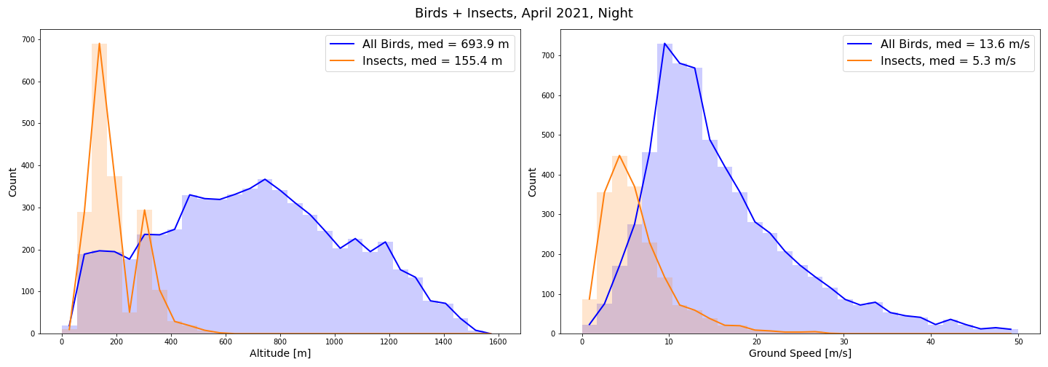

Slide 32
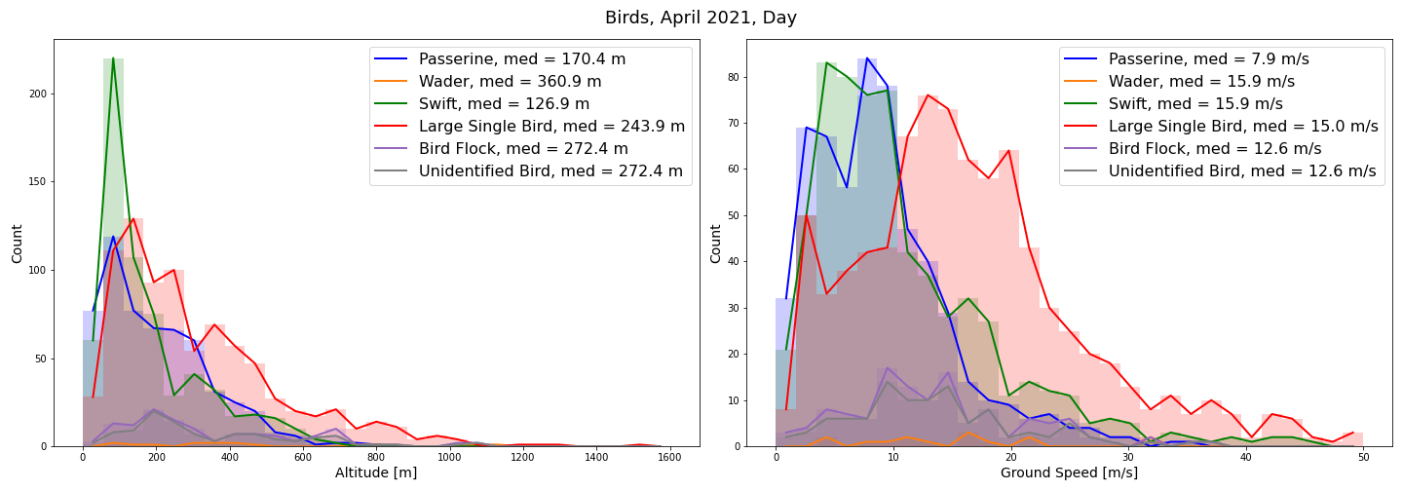
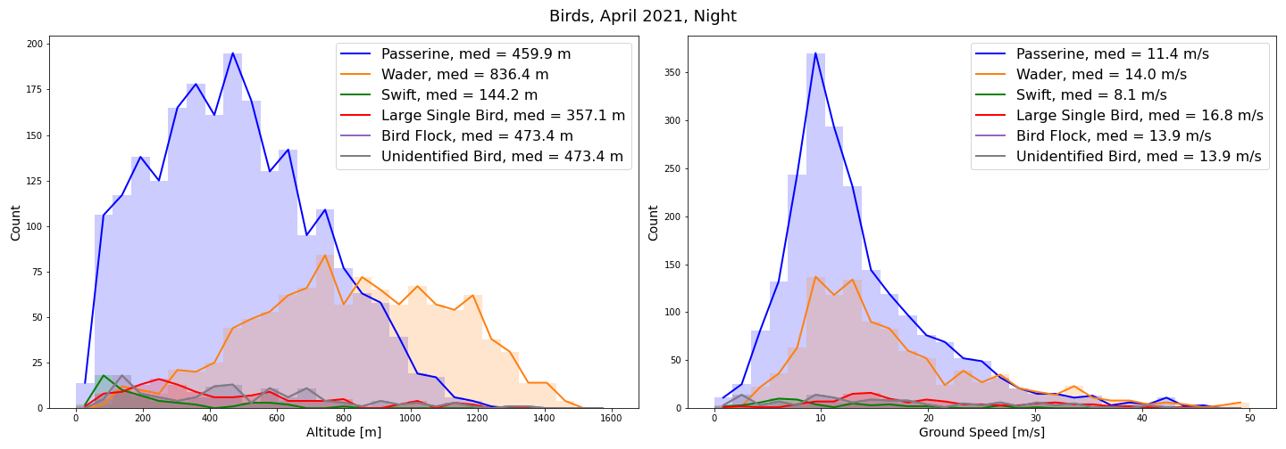

Slide 33
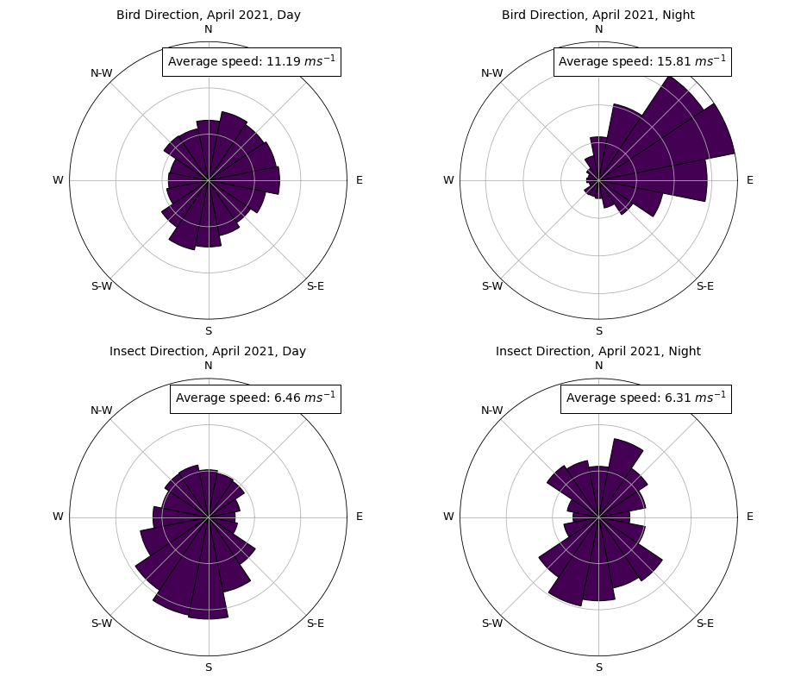

Slide 34
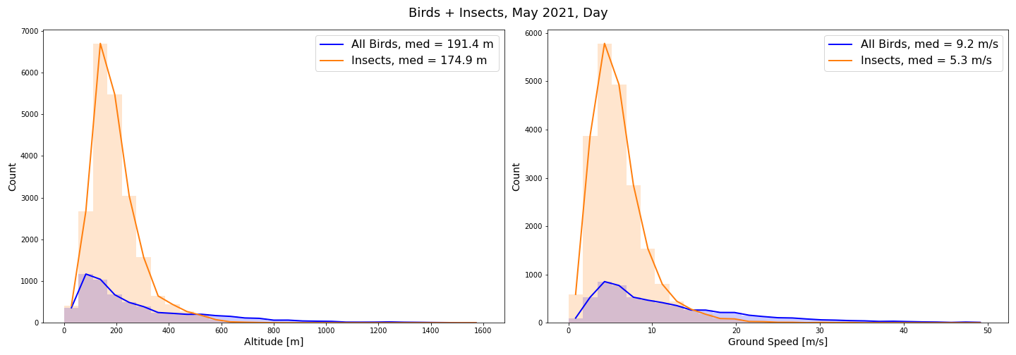
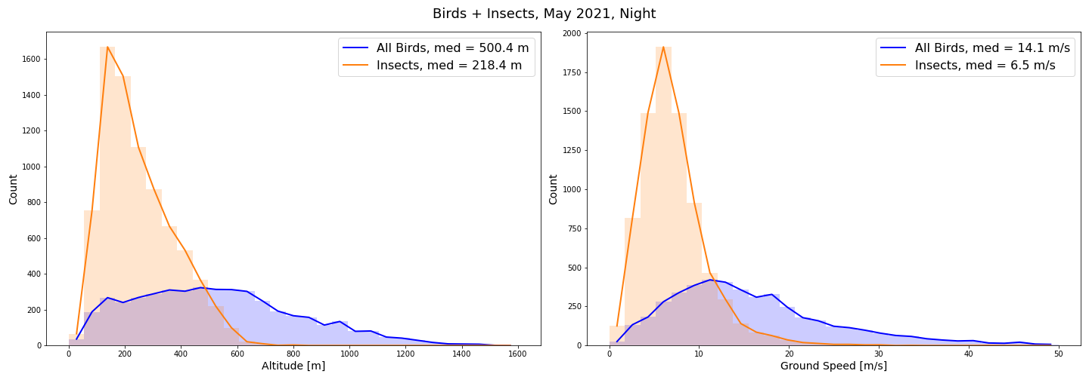

Slide 35
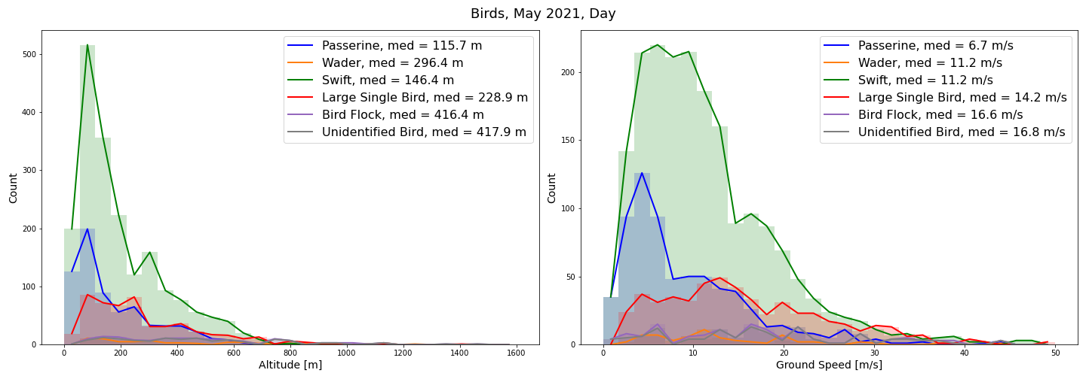
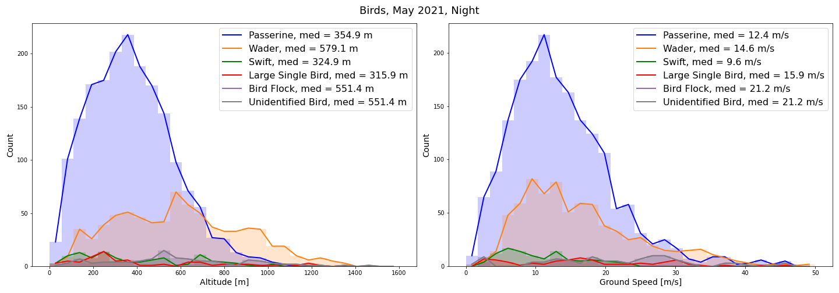

Slide 36
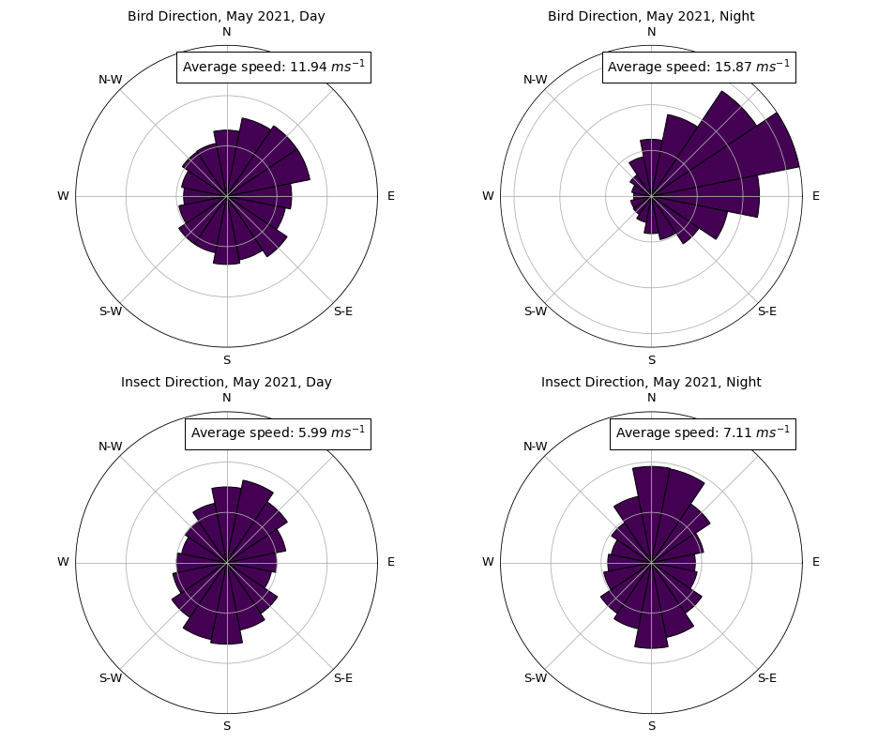

Slide 37
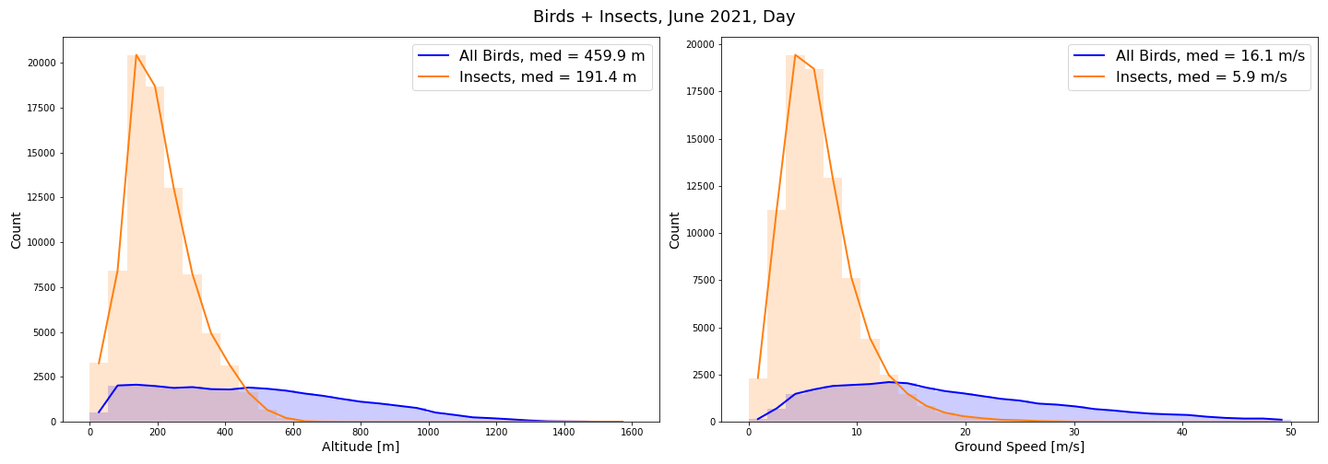
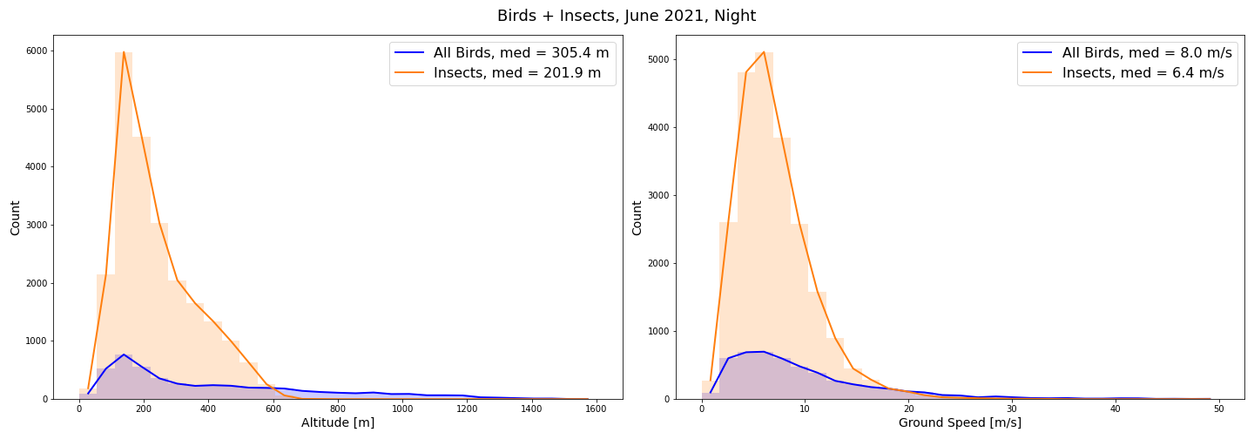

Slide 38
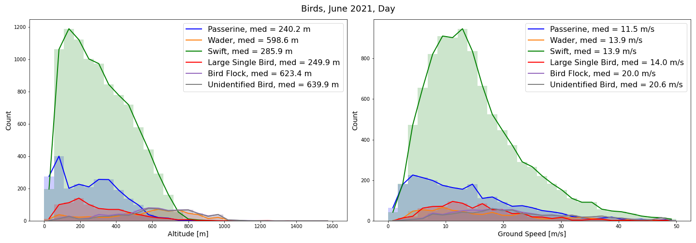
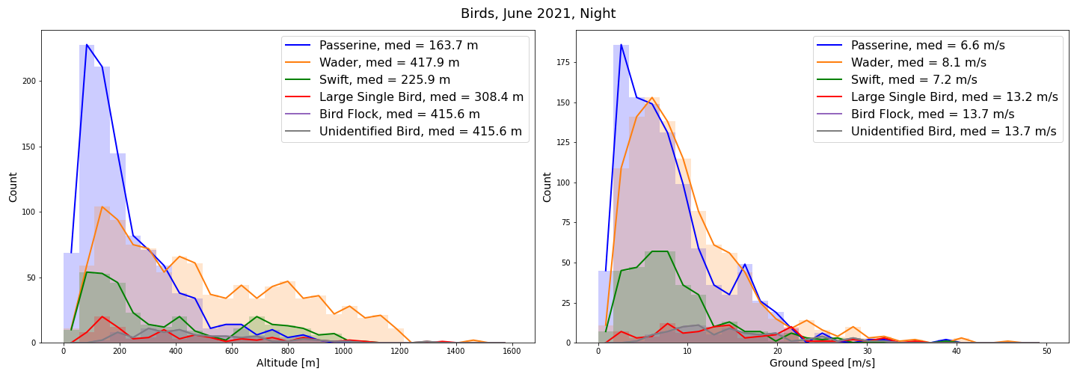

Slide 39
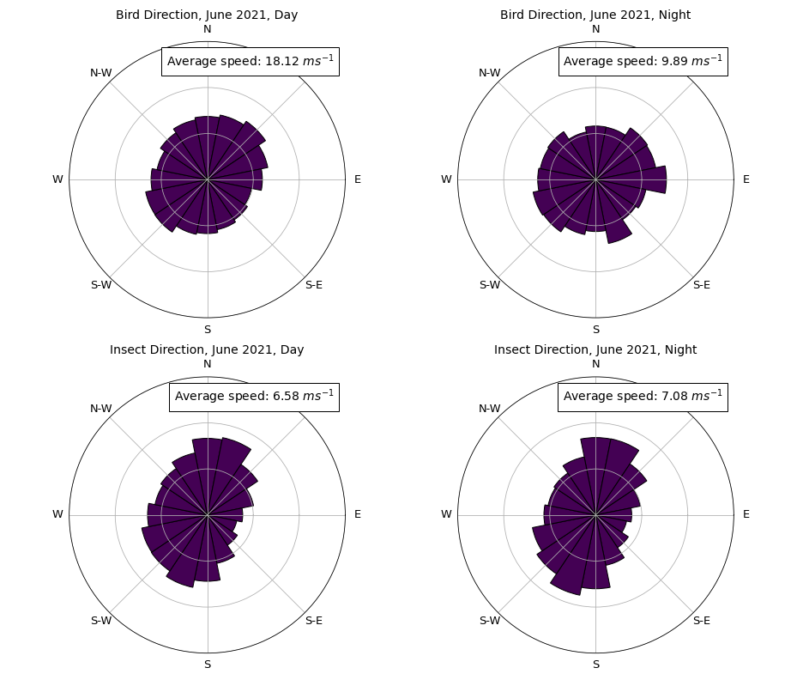

Slide 40
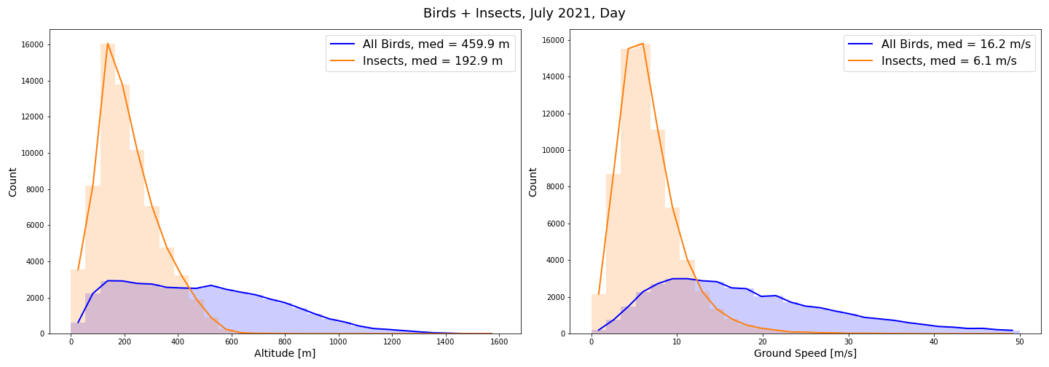
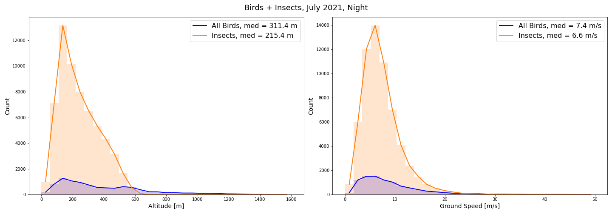

Slide 41



Slide 42


Slide 43



Slide 44



Slide 45


Slide 46
In the following, air temperature @ 2m [deg C] is analyzed in relation to insects’ MTR [individuals km-1 hr-1]
March to July 2021
Time series of MTR and air temperature for each month
Scatter plots of MTR versus air temperature for each month and for day and night, separately

Slide 47


Slide 48


Slide 49


Slide 50


Slide 51


Slide 52


Slide 53


Slide 54


Slide 55


Slide 56


